Slide 1
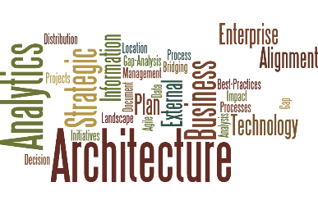
From Strategy to Execution Aligning Architecture Perspectives Starting Point: The External architecture

Slide 2
The Relationship of Architectures
Most Organizations do something here
Enterprise External Perspective
This architecture contains Everything that is going on outside the enterprise, the landscape with possible impact on the enterprise, the ecosystem of the business
Strategic Business Perspective
This architecture contains All the options, decisions, considerations, assumptions that go into deciding on the direction of the enterprise as it responds to the landscape
Business Perspective
This architecture contains all the operational capabilities, resources, assets, skills, intellectual property needed to carry out the direction.
Enterprise Perspective
The enterprise architecture contains All the assets needed to execute the what is put in place by the business architecture, the operational view.
Relationship Analytics Connect These

Slide 3
The overall End-to-End result focusing on Impact Analysis outcomes …
Landscape Architecture
Ranking of Markets
Strategic Architecture
Market-to-Product High Impact Relationships
Business Architecture
Focus areas for: Market – Capabilities
Enterprise Architecture
High-Impact Ranking of Market – Processes
Landscape Sensitivity of markets
Landscape scope
Market – Value Streams
Market – Applications
Market - Databases
Most Organizations do some analysis here, usually requirements analysis
Linkage Analytics (by Inference)

Slide 4
Architectures relate to each other through context maps…
What people know the most about
Enterprise (IT) Architecture
Business Architecture
Strategic Business Architecture
Environment/ Landscape/ Ecosystem Architecture
What people are learning about now
What people know the least about

Slide 5
What comes out of the architecture effort
Documentation of the enterprise structure
A suite of models
Analytic results
Quantitative
Qualitative
Conclusions (one or more)
Suggested direction for operations, business structure, strategic impact etc.
Missing from most projects

Slide 6

Key analytics for architecture
Comparative analytics to deal with consolidation, merger and acquisition
Ranking analytics similar to what is used for impact to identify options
Best fit for matching attributes along with components of the architecture
Affinity analysis to group things
Predictive analytics with clustering to identify hidden relationships for deployment
Impact analysis for linkage between architecture perspectives

Slide 7
How to Analyze the External to Internal Relationships and Impact
Capture the items that make up the category…e.g. Technology Concerns
Capture the linkage relationships to:
Market, Strategy, Initiatives, Missions, Etc.
Identify metrics for the target category
Rank the items based on metrics
Rank the items based on context (a measure of risk)
Create a 4 – box of assessment

Slide 8
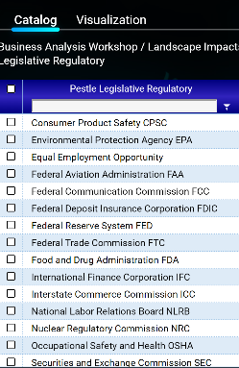
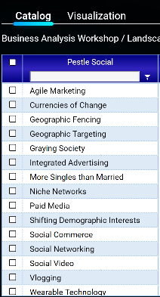
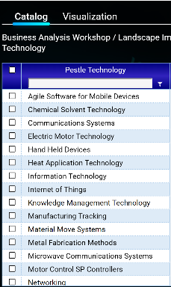
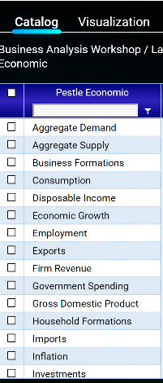
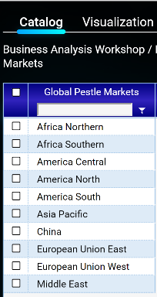
Start by gathering lists of the items of interest in each part of PESTLE-MB
For example,
PESTLE-MB Lists:
Legislative
Social
Technology
Economic
Markets
Note: MB adds Markets and Business Issues

Slide 9
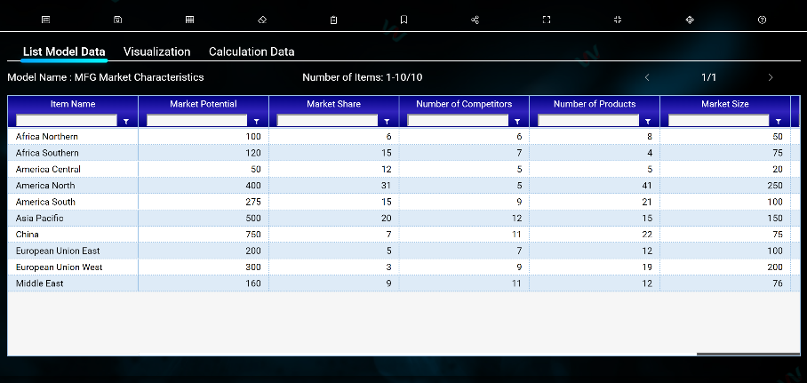
Identify metrics of interest that describe the markets

Slide 10
Organize the market information for consistent ranking
Market Size – 5 is large (1 rank is a small market, sort ascending)
Market share – Percentage (1 rank is small share, sort ascending )
Number of products – largest/smallest (largest is too many, sort descending)
Market potential – 5 is large (1 rank is too small, sort ascending)
Market growth – 5 is large (1 rank is too small, sort ascending)
Number of competitors – largest/smallest (largest is too many, sort descending)
Create a composite value such that:
The smallest composite number is the worst market to be in (Red)
The largest composite number is the best market to be in (Blue)

Slide 11
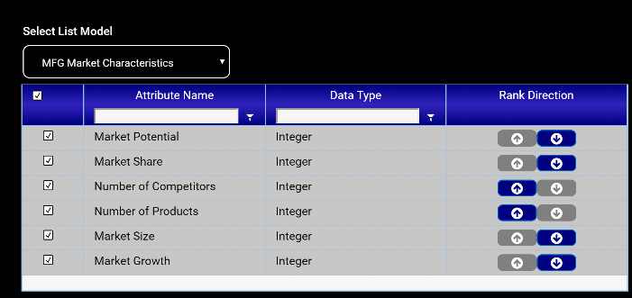
Set up the ranking parameters to rank best market to worst

Slide 12
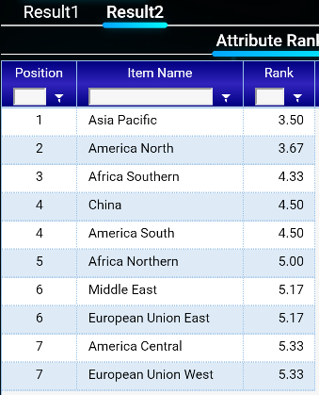
Get a ranking of market desirability
Best Market Opportunity
This implies you have a strategy to go into the market
Worst Market Opportunity

Slide 13
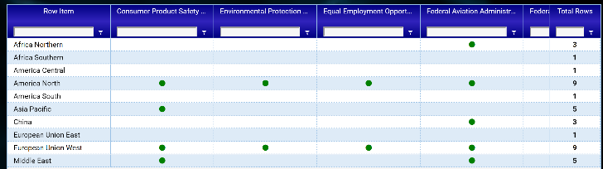
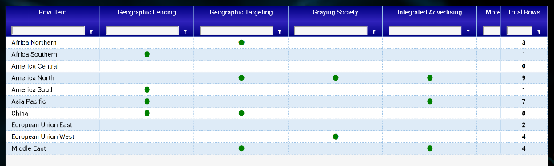
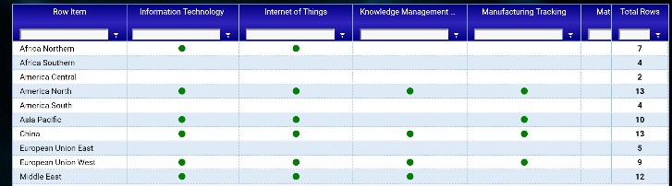
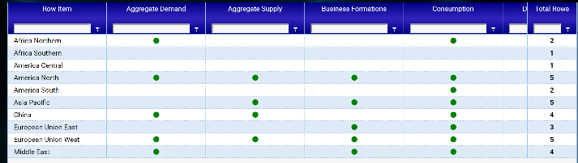
Next Identify PESTLE to market impacts
This requires creating a set of similar matrices and combining the frequencies into a composite view
Row headings are the same in each matrix
Regulatory
Social
Technology
Econometric

Slide 14
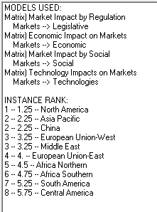
Finally analyze the composite ranking of the markets most likely impacted by changes in PESTLE
Relationships
Metrics
The top-ranked market in the relationship ranking is the one most impacted and the bottom is the least.
The top ranked market in the metrics list is the one that has the best opportunity

Slide 15
How do you apply the results? The Blue /Red Ocean Idea
A Blue ocean is the one in which there are few competitors and you have a hot product
A Red ocean is where there are lots of products and lots of competitors and you are fighting for share
There is a 4-Box way of looking at this

Slide 16
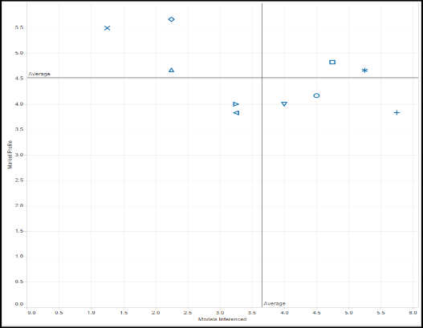
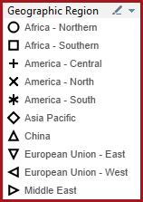
Enterprise Market Opportunity Profile
Blue Ocean- Invest
Murky Ocean
4.52
Explore
Red Ocean - Exit
3.65
Now we need to see what is impacted

Slide 17
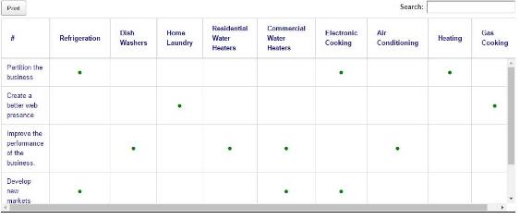
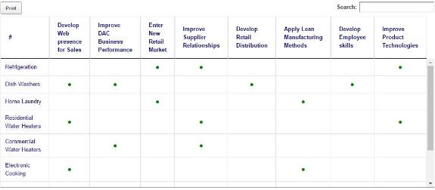
So for simple top down we start with 2 matrices….
Model A – Strategies and Products
Model B – Products and Capabilities

Slide 18
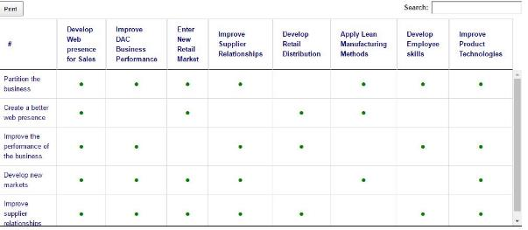
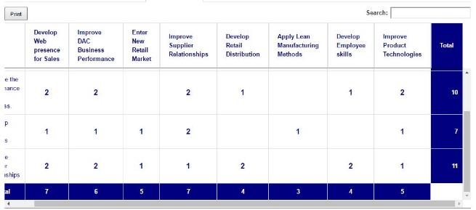
And we get 2 results….
Where are the impacts?
How much of an impact?

Slide 19
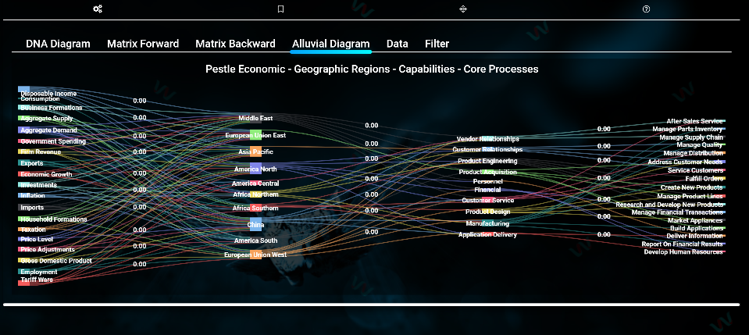
What is really of interest…

Slide 20
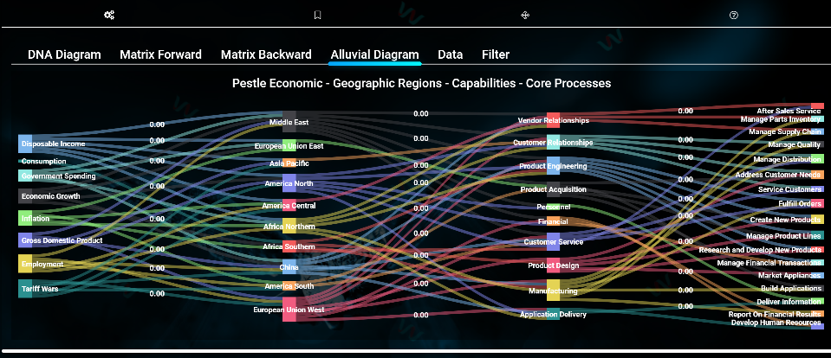
You can filter the result to focus on those items of most importance.
Low impact external factors removed

Slide 21
Remember that there are other analytics that are useful at each architecture perspective
Comparative analytics that deal with consolidation, merger and acquisition
Ranking analytics similar to what was used for impact to identify options
Best fit for matching attributes along with components of the architecture
Affinity analysis to group things
Predictive analytics with clustering to identify hidden relationships for deployment

Slide 22
Some issues with architecture today
Focus on artifacts not outcomes
Few analytics
Bounding the problems
Defining goals
Management does not support outcomes
Multiple approaches
Multiple frameworks
Multiple tool implementations

